Slide 1
HP LIFE e-Learning:
Your Open Educational Resource
Corporate Affairs
November 2013
www.life-global.org

Slide 2
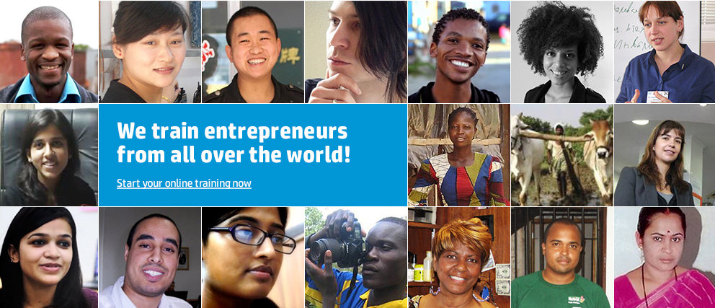
HP LIFE e-Learning for entrepreneurs
A best-in-class IT and business skills solution – free and online
Supporting individuals worldwide to start up and run successful enterprises
    Students
    The unemployed and underemployed
    Micro- and small-business owners
    Mid-career changers
Supporting facilitators to strengthen their services using HP LIFE e-Learning
    Integration in curriculum
    Career planning and development
    Lifelong learning
    A condition of a micro-loan

Slide 3

HP LIFE e-Learning
Benefits as an open educational resource
The content
    Free, branded, and credentialed resource
    Highly interactive and engaging; aligned to core business competencies
    Supports 21st-century skills such as communication, critical thinking, problem solving, and creativity in addition to business and IT skills
    Encourages global and social awareness by featuring real-life entrepreneurs from around the world
Its use
    Flexible-use models, including “flip the classroom” and cohort-based teaching
    Course completion certificate requires completion of all course steps
    Outreach to self-paced learners in alumni and broader communities

Slide 4
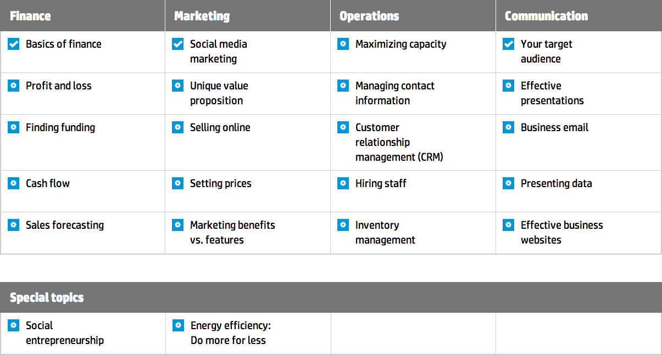
HP LIFE e-Learning
A focus on core business competencies
Content
Interactive, module-based content
Take one course or all of them, as needed
Designed around core business competencies
Resources for trainers and educators
Quizzes and surveys

Slide 5
But so much more than content … an experience
Content
Recognition
Community
Support
Interactive, module-based content
Take one course or all of them, as needed
Designed around core business competencies
Resources for trainers and educators
Quizzes and surveys
Certification
Tell your story –
user-generated content
Discussion forums and chat room
Marketplace – make contacts and exchange messages with other members
Notification and messaging system
Engage on HP LIFE social media
HP experts and volunteering
Workshop facility and webinars
Q&A section: answers from all – students, trainers, HP, etc.
Resource center: tips and advice

Slide 6
HP LIFE e-Learning – course structure
Each course features seven steps:
    Start: a brief overview of course objectives and components
    Story: the scenario of a real-life entrepreneur facing a common business challenge (photo novella with audio)
    Business concept: principles and strategies to respond to the business challenge (with guided and
    unguided interactivities)
    Technology skill: skills linked to the business concept that can help save time and money; includes tutorials, interactivities, and downloadable exercises
    Course discussion: an online global forum to share ideas with others
    Certification: a celebration and validation of your learning; printed or uploaded
    Next steps: additional resources to dive more deeply into the course topics and skills

Slide 7
HP LIFE e-Learning – course structure
Each course features seven steps:
    Start: a brief overview of course objectives and components
    Story: the scenario of a real-life entrepreneur facing a common business challenge (photo novella with audio)
    Business concept: principles and strategies to respond to the business challenge (with guided and
    unguided interactivities)
    Technology skill: skills linked to the business concept that can help save time and money; includes tutorials, interactivities, and downloadable exercises
    Course discussion: an online global forum to share ideas with others
    Certification: a celebration and validation of your learning; printed or uploaded
    Next steps: additional resources to dive more deeply into the course topics and skills

Slide 8
HP LIFE e-Learning – course structure
Each course features seven steps:
    Start: a brief overview of course objectives and components
    Story: the scenario of a real-life entrepreneur facing a common business challenge (photo novella with audio)
    Business concept: principles and strategies to respond to the business challenge (with guided and
    unguided interactivities)
    Technology skill: skills linked to the business concept that can help save time and money; includes tutorials, interactivities, and downloadable exercises
    Course discussion: an online global forum to share ideas with others
    Certification: a celebration and validation of your learning; printed or uploaded
    Next steps: additional resources to dive more deeply into the course topics and skills

Slide 9
HP LIFE e-Learning – course structure
Each course features seven steps:
    Start: a brief overview of course objectives and components
    Story: the scenario of a real-life entrepreneur facing a common business challenge (photo novella with audio)
    Business concept: principles and strategies to respond to the business challenge (with guided and
    unguided interactivities)
    Technology skill: skills linked to the business concept that can help save time and money; includes tutorials, interactivities, and downloadable exercises
    Course discussion: an online global forum to share ideas with others
    Certification: a celebration and validation of your learning; printed or uploaded
    Next steps: additional resources to dive more deeply into the course topics and skills

Slide 10
HP LIFE e-Learning – course structure
Each course features seven steps:
    Start: a brief overview of course objectives and components
    Story: the scenario of a real-life entrepreneur facing a common business challenge (photo novella with audio)
    Business concept: principles and strategies to respond to the business challenge (with guided and
    unguided interactivities)
    Technology skill: skills linked to the business concept that can help save time and money; includes tutorials, interactivities, and downloadable exercises
    Course discussion: an online global forum to share ideas with others
    Certification: a celebration and validation of your learning; printed or uploaded
    Next steps: additional resources to dive more deeply into the course topics and skills

Slide 11
HP LIFE e-Learning – course structure
Each course features seven steps:
    Start: a brief overview of course objectives and components
    Story: the scenario of a real-life entrepreneur facing a common business challenge (photo novella with audio)
    Business concept: principles and strategies to respond to the business challenge (with guided and
    unguided interactivities)
    Technology skill: skills linked to the business concept that can help save time and money; includes tutorials, interactivities, and downloadable exercises
    Course discussion: an online global forum to share ideas with others
    Certification: a celebration and validation of your learning; printed or uploaded
    Next steps: additional resources to dive more deeply into the course topics and skills

Slide 12
HP LIFE e-Learning – course structure
Each course features seven steps:
    Start: a brief overview of course objectives and components
    Story: the scenario of a real-life entrepreneur facing a common business challenge (photo novella with audio)
    Business concept: principles and strategies to respond to the business challenge (with guided and
    unguided interactivities)
    Technology skill: skills linked to the business concept that can help save time and money; includes tutorials, interactivities, and downloadable exercises
    Course discussion: an online global forum to share ideas with others
    Certification: a celebration and validation of your learning; printed or uploaded
    Next steps: additional resources to dive more deeply into the course topics and skills

Slide 13

HP LIFE e-Learning – use
Depends on the needs of learners, resources available, and structure of existing programs
Are you an instructor, trainer, or mentor …
    Looking to enrich an existing curriculum or use a new stand-alone course?
    Exploring ways to increase participatory or group learning?
    Working with one or many students or entrepreneurs?
    Seeking authentic assignments or homework around which you can confirm completion?
    Teaching business, entrepreneurship, or a specific trade or vocation?
Do your learners …
    Feel comfortable with self-paced learning?
    Have access to computers and the Internet while you interact with them and/or outside of class time?
    Need personalized instructor attention?
© Copyright 2013 Hewlett-Packard Development Company, L.P. The information contained herein is subject to change without notice.

Slide 14
HP LIFE e-Learning – pedagogies
HP LIFE
adaptability
Supplement curriculum
Group coach
1:1 coach or mentor
Flip the classroom
1
2
3
4
Individual work outside classroom
Enriches existing curriculum
Enables deep learning
Individual work outside
For small groups of trainees
High attention on each learner
Limited learner prerequisites
Guided exploration
Individualized attention
1 or 2 computers
Limited learner prerequisites
Individual work outside classroom plus small-group work inside
Supports peer-to-peer learning and sharing
  Depends on the needs of learners and educators

Slide 15
Supplement curriculum – example
1
Integration into a face-to-face course in a community college
Course
    Integrated into Entrepreneurial Ventures, a business planning course
Class outline and HP LIFE courses used
Business concept statement
Unique value proposition
Product/service planning
Marketing benefits vs. features
Management and organization
Hiring staff
Marketing
Your target market
Customer relationship
management (CRM)
Effective business websites
Social media marketing
Setting pricing
Financial
Basics of finance
Profit and loss
Cash flow
Finding funding
Sales forecasting
Teaching methods
    HP LIFE 3-minute Story scene setter is played to the whole class
    Students work on HP LIFE Business Concept activities; educator circulates answering individual questions; offering personalized guidance
    Instructor-led class discussion resumes; talking through questions and sharing ideas
    HP LIFE Technology Skill assigned as homework; course completion certificates uploaded in the Learning Management System or dropbox
    HP LIFE Next Steps resources are used the next day to deepen class discussion

Slide 16
Group coach – example
2
Encouraging participatory and peer learning
Challenge
    Instructor keen to bring more collaboration and dynamism into college class in public health
How it unfolds
    Story scene setter of Social Enterprise course is played to the whole class; after which students create small
    teams of enterprise “co-owners” to select the public health challenge they want to solve
    Teams gather around a computer and work through Business Concepts; teams sketch out and discuss
    their social enterprise plan with the instructor
    Technology Skill on data collection software is taken independently; research plans devised;
    Your Target Audience course assigned before student teams reach out to the community to collect data
    Effective Presentations course is assigned to teams; multi-disciplinary panel of faculty invited to hear
    and score final proposals

Slide 17
1:1 coach or mentor – example
3
Integration into small-business counseling
Step 1: Definition of mutually agreeable objectives for the mentoring relationship
    Help a micro-business owner improve business performance
    Increase owner confidence and capabilities to seek out additional online resources in the future
Step 2: Site familiarization
    Narrow in on priority business competencies to improve
    Register and walk through HP LIFE e-Learning together explaining structure of site and
    individual courses
    Begin first course; watching Story scene setter, then working through Business Concept
    and Technology Skill together
    Print certificate and offer feedback and encouragement
    Learner continues using courses and checks back with mentor periodically for guidance

Slide 18
Flip the classroom – example
4
Integration into small-business counseling
The scenario
    Small-business centers (SBCs) provide a range of programs and services for existing and prospective
    local business owners; one service is offering individual counseling
“Flip the Counseling” session
    Prior to SBC counseling sessions, SBCs provide information about HP LIFE e-Learning via a link and
    promotion on their website and suggest that business owners complete one or more relevant courses
    Counseling sessions take place where knowledge gaps are identified; business owners are pointed to
    specific HP LIFE e-Learning modules alongside local resources as required
    HP LIFE e-Learning course completions made a precondition to receiving a small-business loan or
    additional counseling

Slide 19




HP LIFE network of institutional collaborators
    Be the next to join in
    U.S. community colleges
    Small-business centers
    Entrepreneurship training centers
    Women’s networks
    Youth networks
    Distance learning and online universities
    University Entrepreneurship Club organizers
    Entrepreneurship competition organizers
    Independent mentors
With thanks to our partners

Slide 20
The HP LIFE e-Learning Ambition
Imagine, this decade
    We empower millions of youth and aspiring entrepreneurs to create jobs and lift up communities worldwide
    We enable tens of thousands of schools, training centers and other small business support organizations to personalize their support offerings and at scale
Core Contributor
Strengthen the HP LIFE offering at its core
Catalyst and Convener
Tap into networks of institutions & entrepreneurs
Collaborating Institution
Provide direct support to our ultimate beneficiary
Target Audience
Un/underemployed
Students Entrepreneurs
Small Business Owners
The ultimate beneficiary
We can do this, together

Slide 21



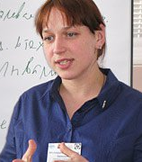

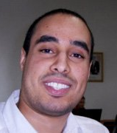
HP LIFE demonstrated impact
Since 2007 over 2 million people reached
Helped to establish
and expand >25,112 businesses
Over 57,000 new jobs created or employment obtained
Face-to-face training centers around the world
Global partnerships with leading organizations – EDC, USAID, UNIDO, NACCE, UoPeople, Indiana U
A growing pool of trainers building out new use cases
Since mid 2012
HP public cloud based
e-learning solution for millions of entrepreneurs
120,000+ registered students from over
200 countries/territories
in 14 months
Content available in English, Spanish, French, Portuguese, and Arabic with more to come

Slide 22
“The betterment of society is not a job to be left to a few. It’s a responsibility to be shared by all.”
David Packard

